Slide 1

Tencent Cloud Super App Solution
rainxing

Slide 2




About Tencent
Vision & Mission
Positioning
Values
Value for Users,
Tech for Good
An Internet-based
Technology and
Cultural Enterprise
Integrity, Proactivity,
Collaboration, Creativity

Slide 3
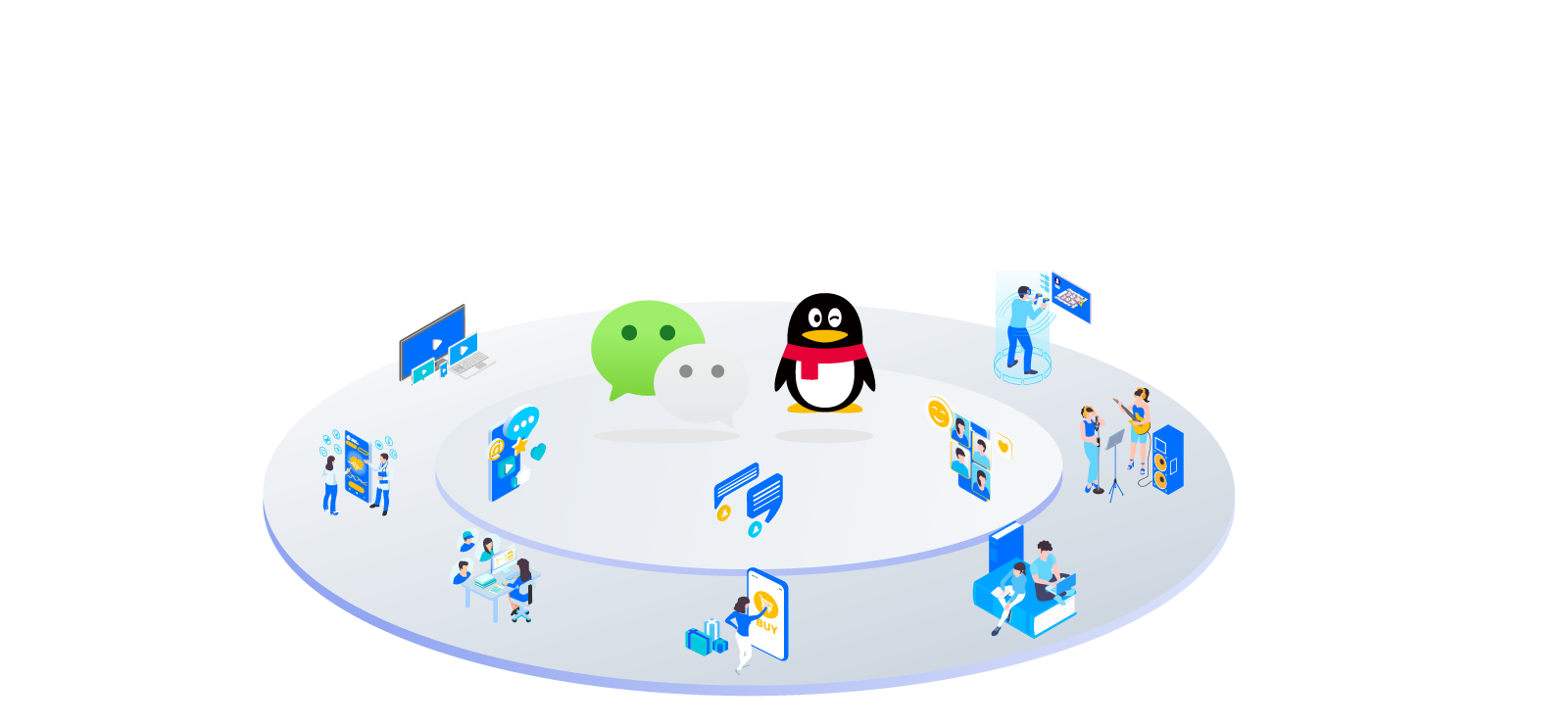
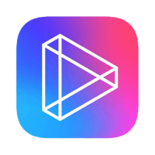



















Digital Ecosystem Fulfilling Everyday Needs of Consumers
1 billion+
RMB1.6 trillion+
226 million
daily average commercial payment transactions
on Wechat Pay ⁽¹⁾
total transaction value generated from
Wechat Mini Programs ⁽²⁾
total fee-based
VAS subscriptions ⁽³⁾
Watching
Videos
Playing
Games
Tencent
Video
WeiShi
Wechat Video Accounts
Tencent
Games
Mini
Games
wechat
QQ
Sharing
Socialising
Tencent
Health
Tencent
Medipedia
Health
Code
Listening
And Singing
Seeking Medical Help
Communication
QQ Music
WeSing
Kugou
Music
Kuwo
Music
Reading
Work and Collaboration
Payment
Transactions
WeCom
Tencent
Meeting/
VooV
Meeting
Tencent
Docs
QQ
Reading
Qidian Reading
wechat Reading
wechat Pay
QQ Wallet
Since 4Q2019
Annual transaction value in 2020
Fee-based VAS subscriptions as of Mar 31, 2021

Slide 4











Wechat Reshapes Digital Lifestyle in China
Wechat Chat
Chat and Moments
Wechat Chat provides synchronous communication between mutual contacts
Moments provide asynchronous photo, video and audio sharing
Moments
Video Accounts
Wechat Pay
Easy and secured online/offline transactions
Over 1 billion average commercial transactions per day since 4Q2019
Mini Programs
Official Accounts
Mini Programs
Provide Wechat users with products, content and services
Assist businesses in building digital presence
2020 annual transaction value more than doubled YoY
Connecting People, Enterprises,
Content and Services
Official Accounts
Allow individuals, media and businesses to share original content and engage with readers
Strengthen brand awareness and content management
Wechat Search
Wechat Pay
Video Accounts
Facilitate public sharing of video and live streaming content
Help content creators and brands acquire and manage customers efficiently
Top Stories
Mini Games
Largest communication and social service in China for over 1.2 billion MAU ⁽¹⁾

Slide 5











MiniApp becomes Chinese new operation system, the new technical standard of Internet market
7+
million
600+
million
200+
Total number of
MiniApp
Industry Coverage
DAU of WeChat
MiniApp
11 Top Series of MiniApp
Baidu
ByteDance
Kuaishou
Netease
Xiaomi
Tencent
Alibaba
JD
Meituan
360
Huawei HMOS

Slide 6

With 600 million DAU, Wechat MiniApp has become an important window to various services for Chinese market
2022年
2022
2020
MiniApp
DAU
400million
Mini App Dau600 Million
2019
2018
MiniApp
DAU
330million
2017
MiniApp
DAU
230million
MiniApp
DAU
170million
Million
3.46
21.4%
2.72

Slide 7

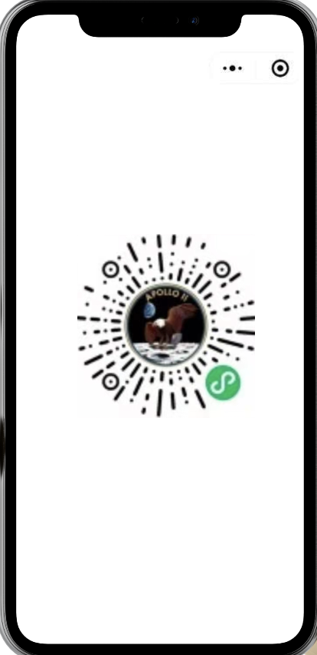

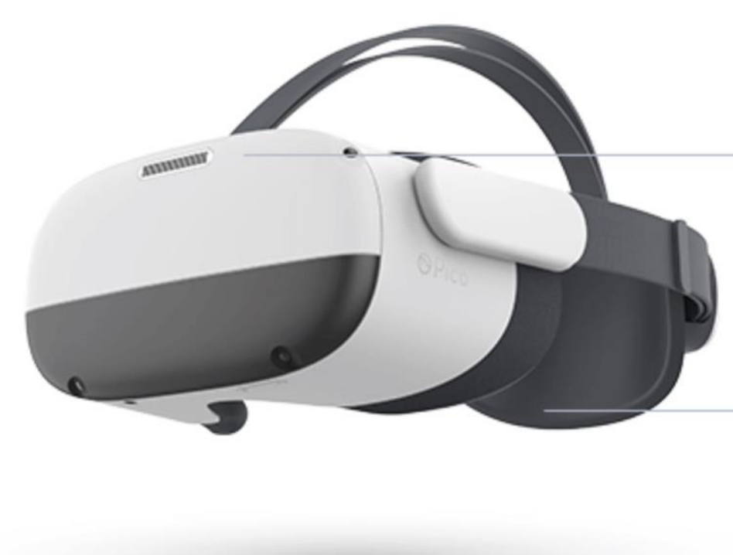

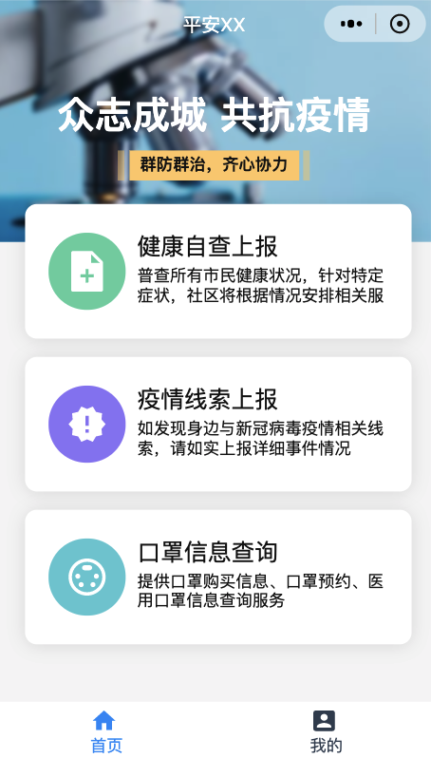
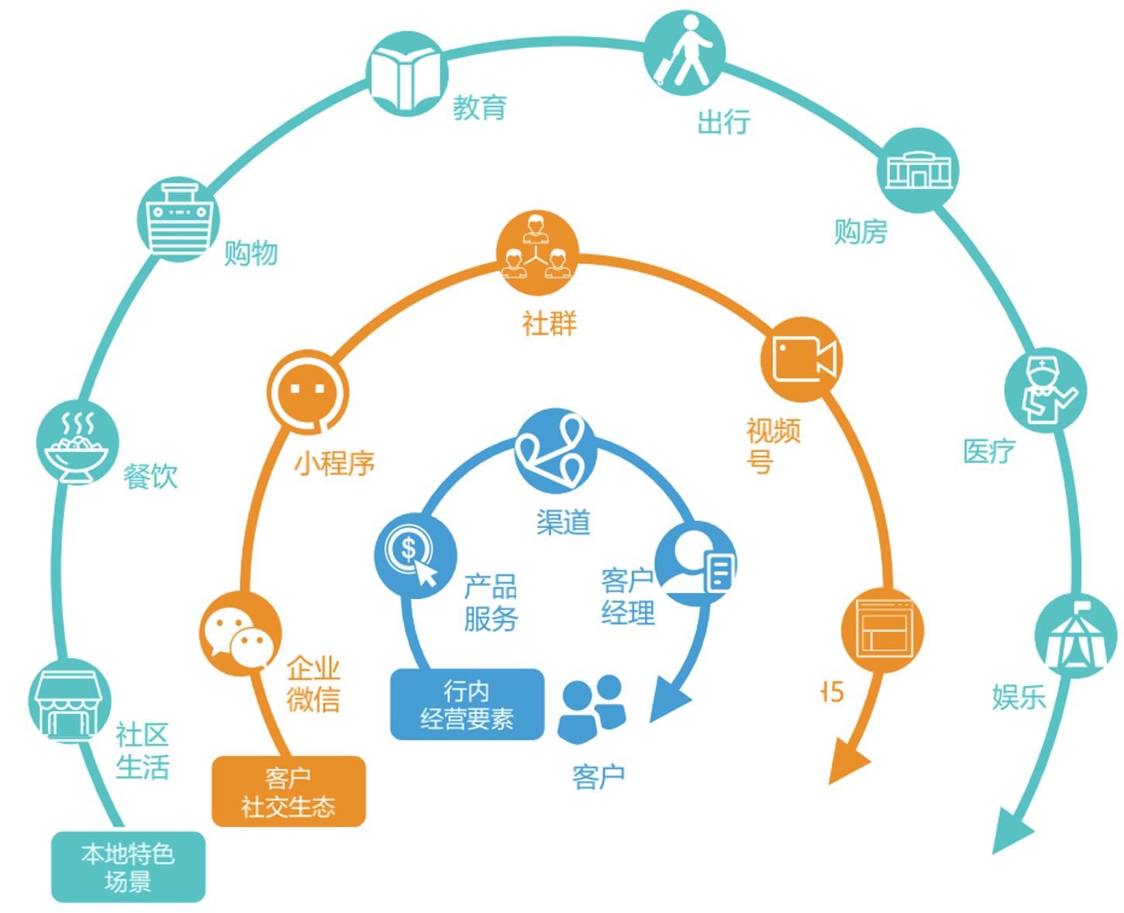
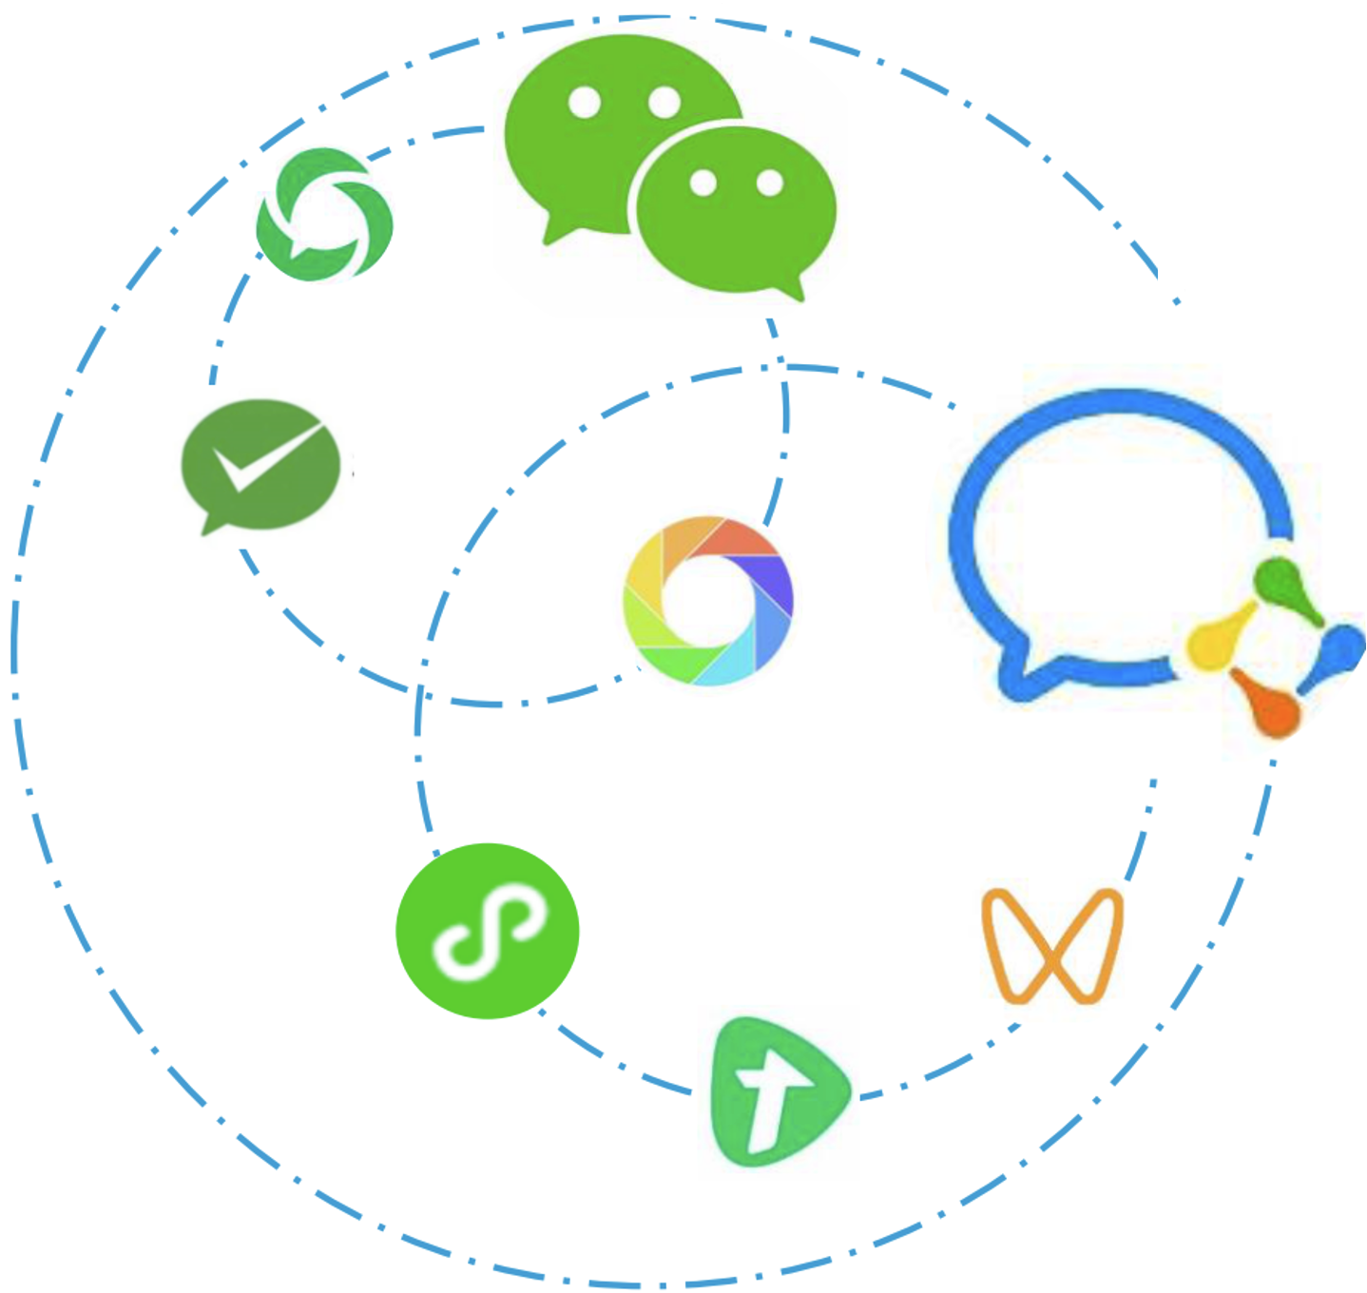
Integrated Solution For Super App
Mobile APP
MiniApp
SDK
XR
H5
Scenario
tourism
Pan-Internet
Retail
Education
Industrial
User Experience
Gov.
Finance
UI Design
Smart Marketing
Open Ecosystem
Innovative Business
Service Scenario
Business
UE Design
Credit
A/B Test
Open API
Sandbox
Digital Human
NFT Marketing
Online Payment
Customer Service
Gen. Z Design
Mobile Gateway
Mobile Analysis
The aged
Design
Container
Code mgmt.
TMF
R&D
Framework
Message Push
Mobile Monitor
Mini APP
R&D Console
DevOps
Unified
CI/CD
Agricultural Design
Super
APP
Mobile Security
Mobile
Test
Ecosystem
Artifice mgmt.
non-barrier design
User Experience
PAAS
Technical Platform
AI Platform
Vide Platform
Big Data Platform
Business Platform
Design
Consulting
IAAS
Cloud Service
Design
Review

Slide 8
Super App Key Supported Platform -- TMF
CONFIDENTIAL PROPERTIES

Slide 9



Challenges in Super App development
Development and operations difficulties mainly lie in-app performance and the efficiency of development and operations teams.
Insufficient app performance
Low efficiency of internal development
Empirical operations
Packages are large and slow to be started and run unstably
Bugs are not discovered until they are complained about and not fixed promptly
UIs are not unified and hard to be aligned on both ends
...
Each team develops independently and reinvents the wheel
All tests are performed manually with poor effects
After app release, app teams almost have no control on the client, and the effect is left to chance
...
Only a small number of data dimensions are provided, hindering decision making
There are few operations tool, making fine-grained operations impossible
...

Slide 10
TMF overview: through the entire lifecycle of Super APP from development to operations
Development efficiency product package
Service product package
Test product package
Cloud Phone
Automation
Feature, performance, and compatibility
DevOps
Code quality
Development specifications
Development support
Quality assessment
Security product package
Environment check
Business operations product package
Operational analysis and optimization
Ecommerce/Content/Benefits
Capability scenario product package
Pseudo base station detection
User/Channel/Page
Activity/Inactivity
Live streaming/VOD
Payment/Wallet
A/B test
Smart placement
Benefit mall
Smart customer service
Virtual human
Secure information channel
SDK sandbox
Basic component library
Business component library
Mobile gateway
Source code obfuscation
X5 browser
HTML5 container
Basic component
Public component
Mobile middle end product package
QR code scan
Social sharing
Positioning
Basic component
Piracy detection
Mobile release
Mobile push and sync
Others
Malicious Wi-Fi detection
Mobile monitoring
Mobile analysis
OCR
App release and update
Offline package
Hotfix
Message push
Data sync
Grayscale
Basic component
Basic component

Slide 11


TMF Features-- Client components
Multiple project teams can develop at the same time more efficiently without interfering with each other. The code is decoupled to facilitate code management. Public modules are extracted separately to increase the reusability and reduce the development workloads.
TMF supports major iOS, Android, and HarmonyOS versions such as iOS 16 and Android 12, keeping up with the updates of Apple and Google
TMF componentized development framework
2
Each team develops an independent feature and performs local debugging
Host layer
App 01
App 02
App 03
App 04
...
Business layer
Business module A
Business module B
Business module C
...
Team A
Team B
1
Basic feature modules are encapsulated
Mobile gateway
Cloud instruction
HTML5 container
Push component
Business module A
Business module B
API layer
API layer
TMF mobile development kit
Hotfix
Storage component
Operational statistics
Offline package component
QR code scan and recognition
Positioning component
UI component
Encryption component
Implementation layer
Implementation layer
Image compression
Version upgrade
Colored log
...
Framework
layer
Comment
Comment processor
TMF core
ServiceManager
3
Modules developed by different teams can call APIs provided by other teams
The mobile development framework supports concurrent development by multiple teams

Slide 12







TMF Features– More Client components
TMF supports many general client capabilities to meet the universal needs of different types of business apps
UI component a mature UI construction plan covering both Android and iOS
QR code scan the same as that in WeChat
Recognition rate
Bar code
QR code
Global UI configuration
Global app layout adjustment on the same configuration table
Multiple UI controls
Multiple styles accumulated in actual product iterations
99%
Positioning integrated Google Map positioning service
High accuracy
High confidence
Rich APIs
Unified storage diverse storage methods for different requirements
GPS: about 20 meters
Wi-Fi: 30–180 meters
Base station: 150–800 meters
Success rate:
99% in the Chinese mainland
98% outside the Chinese mainland
Positioning, reverse geocoding, and POI query
Database storage
WCDB as used by WeCom
KV pair storage
MMKV as used by WeCom
Sharing support for major social networking apps
File storage
Tencent Mobile Manager with RSA and SM4 encryption methods available
WeChat, WeChat Moments, Telegram, WhatsApp, Facebook, etc.

Slide 13
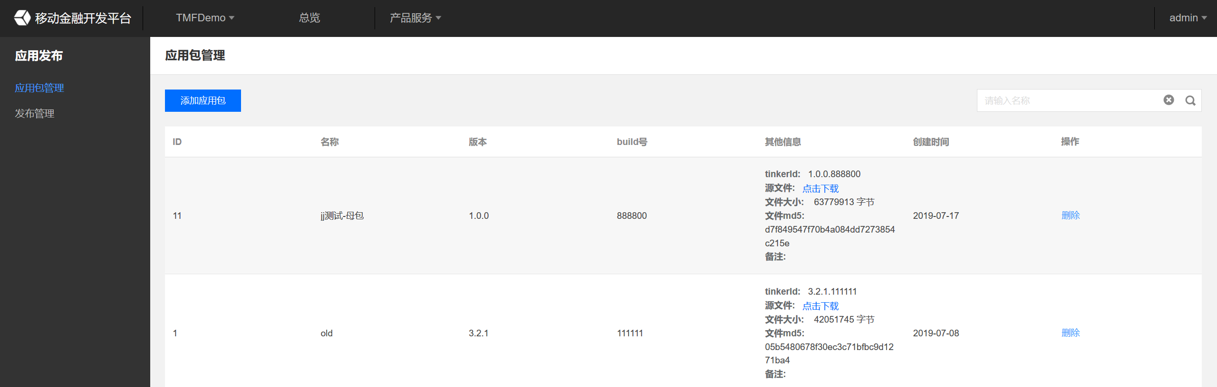
TMF Features– Middle-end services: App Release
TMF supports version release management for Android APKs and offers flexible and controllable release policies.
Android app management
App release management (refined release policy)
APK management
Dynamic grayscale release and management
All APKs are managed in a unified manner and recorded permanently
Rich grayscale rules
Diverse release policies
Flexible rule engine
Push time
Daily push time
Push limit
Release management
GUID
Android IMEI
Region
Each release record is clear and searchable, facilitating progress controllability
Product version
System version
Model
Push frequency
Network environment
ISP

Slide 14





TMF Features– Middle-end services: offline package - static resource management and flexible update methods
The offline package feature of TMF packages the static resources of a page, downloads and deliver to the local device in advance, and opens the package in the client on demand, which minimizes the impact of the network quality on loading HTML5 pages
Admin
Management backend
Client
Instant loading
Analysis
Offline package upload
Check for update
Policy distribution
Click
Effect reporting
Loading time comparison
Dynamic update implementation
During new version launch or emergency release, you can place modified resources in an offline package and make the app automatically download the update through update configuration. In this way, you can push updates to users as soon as possible without waiting for the approval by the app marketplace.
Improved user experience
You can use an offline package to embed static page resources into the app and then release the app, so users can immediately access the resources when opening the app for the first time with no need to download them over the network.

Slide 15
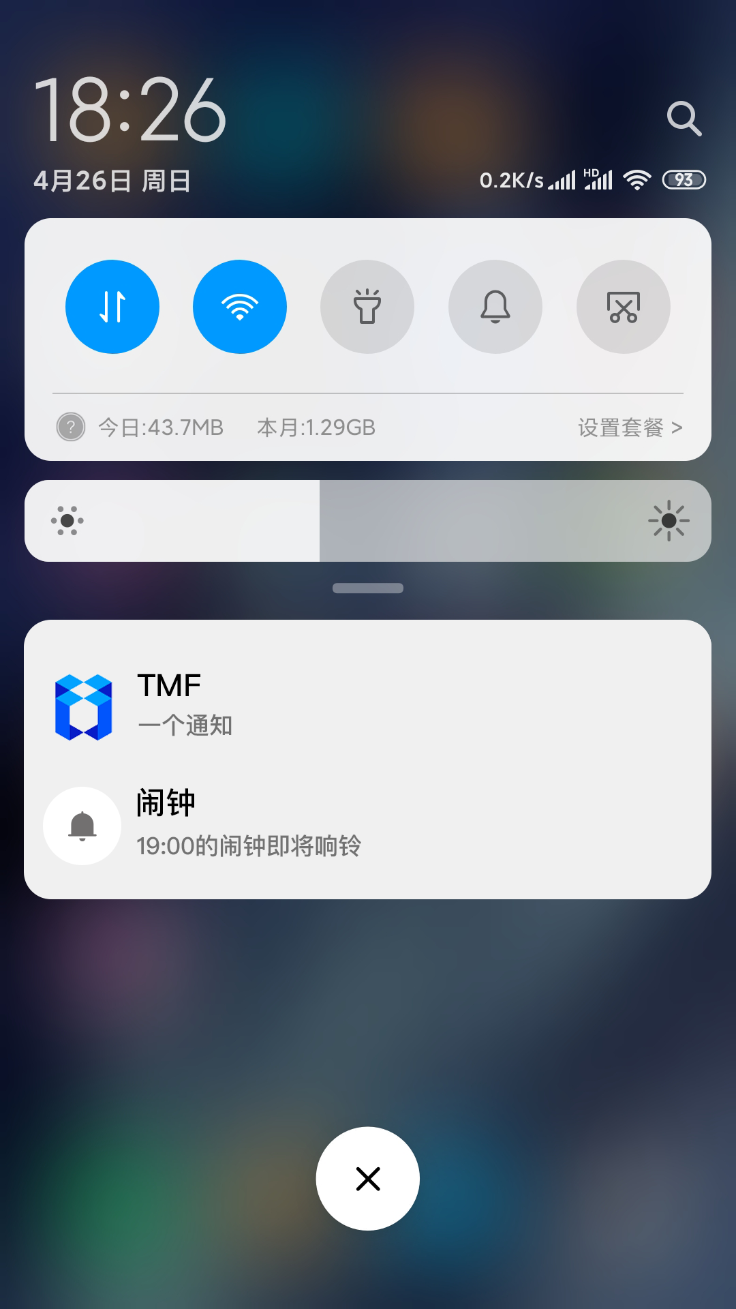






TMF Features– Middle-end services: Message Push
TMF supports dual-channel push, covering the channels of major phone brands with
a deliverability of over 99%.
Business trigger
TMF
Message push
Console
Simple configuration backend
Push API
Effect diagram
Click effect
Additional parameters
Data reporting
Message push service
Own channel
Vendor channel
Support for major vendor channels
Dual channel
Google FCM
Message display
User click

Slide 16
TMF Features– Middle-end services: Mobile Performance Monitoring
SDK
Monitoring configuration
Crash
Lag
Power consumption
Memory exception
Network exception
Defect monitoring
User behavior
Monitoring throughout the entire process of user behavior
Scenario monitoring
Start duration
WebView
JavaScript exception
Analysis reporting
Data display and interaction
Multiple chart types
Real-Time monitoring data
Multidimensional analysis data
Report and alarming configuration
Scheduled report
VIP alarming
Data storage
Most widely used free solution in the industry - Bugly (provided by Tencent)
offers capability accumulation, full capabilities, and enterprise platform QAPM
Bugly solved the top 3 problems for a Chinese large state-owned bank,
decreasing the crash rate from 1% to 0.1‰,
while the industry standard is 3‰
The business experience is anticipated from the perspective of users
Web service

Slide 17
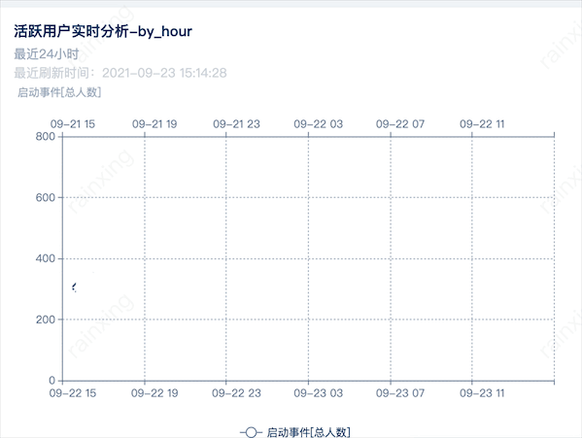
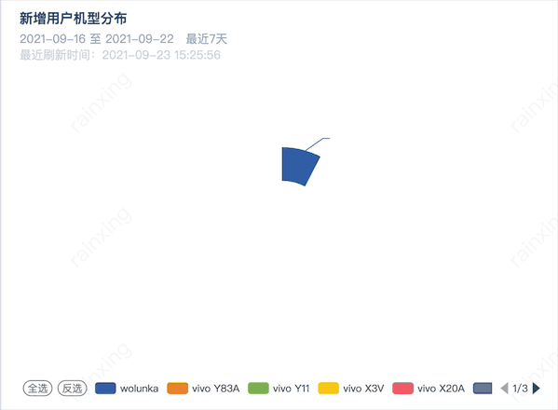
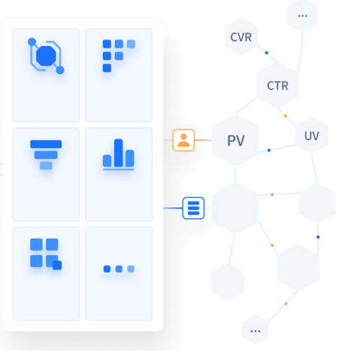
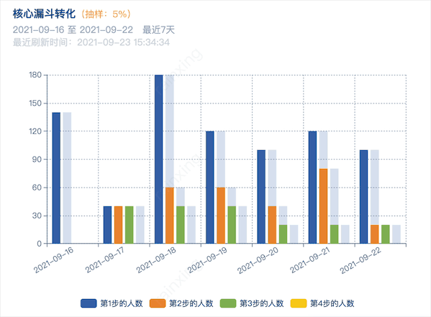
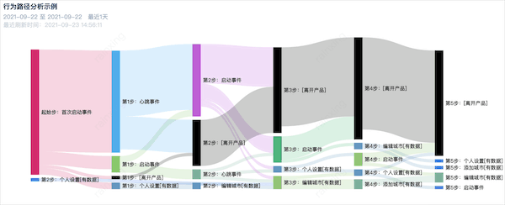
TMF Features– Middle-end services: Mobile Analysis
TMF aggregates Tencent's experience in mobile operations and is preconfigured with expert metrics, helping drive business growth with data.
Analysis
Presentation
Analysis model
Event analysis
Analysis model
Retention analysis
Cleansing
Analysis model
Funnel analysis
Analysis model
Distribution analysis
Behavior
Age
Collection
Definition
Gender
Industry
Analysis model
Drag-and-Drop analysis

Slide 18
TMF Features– Back-end services: Mobile Gateway
Mobile gateway is a componentized product that connects client and server APIs. It simplifies data and communication protocols of APIs to separate the frontend and backend, greatly improving the development and network communication efficiency.
Client
TMF
Mobile gateway
Console
Basic modules
Security
Channel
Information
Control
Key rotation
Persistent connection
GUID
Generation and registration
Key rotation
Data encryption
Connection management
Data decryption
Data compression
Routing
Profile management
Data decompression
Easy configuration
High adaptability
Visual operations
Ultimate optimization
Common features
Result caching
Timeout settings
API mocking
API authorization
API test
Signature verification
TARS/HTTP forwarding
Polling/Hash
Business service

Slide 19




TMF Features– Back-end services: More
AI Engines On-prem
Capabilities developed by Tencent Youtu Lab
OCR
Liveness detection and face comparison
Image and text recognition technologies
Authentication of object's real biometrics and verification of object identity
Identity card
Bank card
Reflection
Motion
Comparison
1220 0034 4490 1112
* Other identity documents or objects to be recognized
Large file transfer
After being uploaded to the server, the parts will be combined by the server
The client uploads file in multiple sequential parts
Only a part will be lost if the upload fails
Image compression
Original file
Multipart upload

Slide 20



TMF security capabilities - stable protection solution based on many years of experience and solid technical groundwork
Tencent has the largest risk library in Asia. The security manager apps of major phone brands such as Apple, Huawei, Xiaomi, and Vivo all depend on Tencent, and all discovered and scanned risks will be sent to Tencent for detection.
Secure
keypad
Environment monitoring
App reinforcement
App runtime environment check
Core
businesses
Tamper proofing and counterfeit prevention
Malicious data acquisition prevention
Whitebox
encryption
Linkage
protection
Seven security labs
Over 90 mobile security protection capabilities
Ten years of experience in mobile security protection
Fake app detection
Fake app detection based on coverage of massive numbers of devices

Slide 21
TMF Coding DevOps Platform – Super APP R&D Work Flow
IDE connects with code repo. and artfice mgmt.
IDE calls
CODING building code and trigger component
Will upload to TMF after artifices completed
TMF provides QR code for installation and installation test
Requirement Analysis & Design
Testing Unit
Development & Test Environment
Integrated R&D
Development & Test Environment
Integrated Test
UI/UE Design
Modularized Coding
Project mgmt.
Mobile Design Service
TMF R&D Framework
Unit Test
TMF IDE Command
TMF Code Scanning installation
Requirement Analysis
The aged design
TMF IDE Pulg-in
Code Scanning
Cert/Signature mgmt.
UI automatic proofread
Mobile component design
Code Repo, mgmt.
Quality Control
On-demand development
APP function test
Artifice mgmt.
Defect mgmt.
Will release after artifices uploaded to TMF
CODING test calls
automation testing interface of TMF
CODING will call the interface of TMF APP reinforcement
Will upload to TMF after artifices completed
TMF provides QR code for installation and installation test
Gray Release
Production Environment
Integration Test
Production Environment
Integration R&D
UAT Environment
Integration Test
UAT Environment
Integration R&D
Official Release
Multi-channels release
APP Gray release
TMF code scanning installation
Cert/Signature mgmt.
TMF code scanning installation
Cert/Signature mgmt.
Offline package release
Offline package gray release
APP function test
On-demand development
APP function test
On-demand development
performance monitoring
APP compatibility test
TMF APP reinforcement
Defect mgmt.
Hotfix release
APP compliance test
APP security mgmt.
Defect mgmt.
Notes:
Tencent Cloud TMF Coding DevOps solution provides developers an one-stop DevOps service platform throughout the lifecycle of software engineering as project planning and management, requirement management, Code Repository, and Continuous Integration, Artifacts Management, and Continuous Deployment until final release.
Combine Agile development + Devops
Requirement Management
Iteration Planning
Dev&Test Collaberation
Iteration Analysis
Knowledge Base
Code Management
Continous Integration
Deployment Management

Slide 22
TMF MiniApp Platform
CONFIDENTIAL PROPERTIES

Slide 23
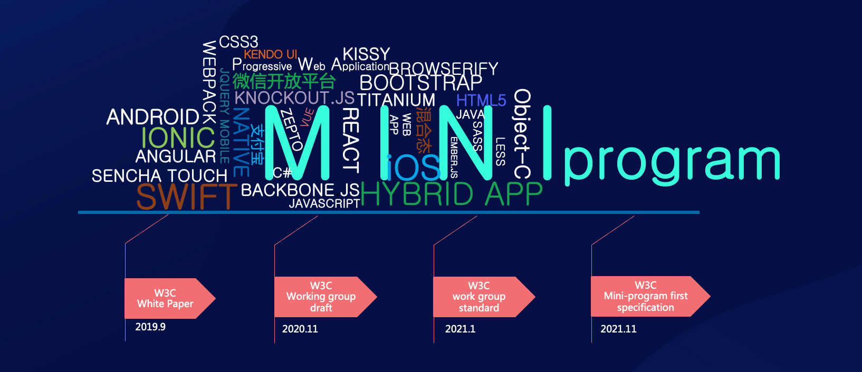
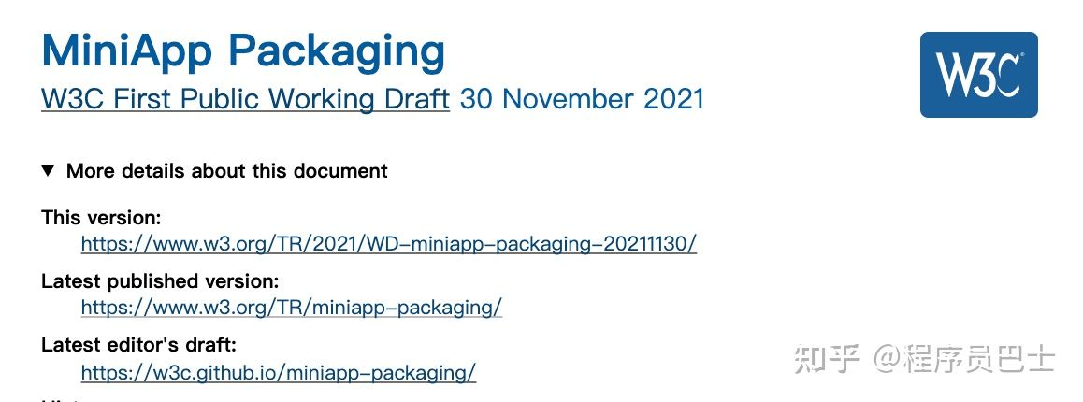
W3C MiniApps specification, Chinese standards go to the world
The MiniApp Packaging specification defines the semantics and consistency requirements of MiniApp packaging files, including file structure, configuration files, static page templates, style sheets, JS documents, media files and other resources, etc. Examples of MiniApp packaging are used for distribution in the runtime environment and execute MiniApp.

Slide 24

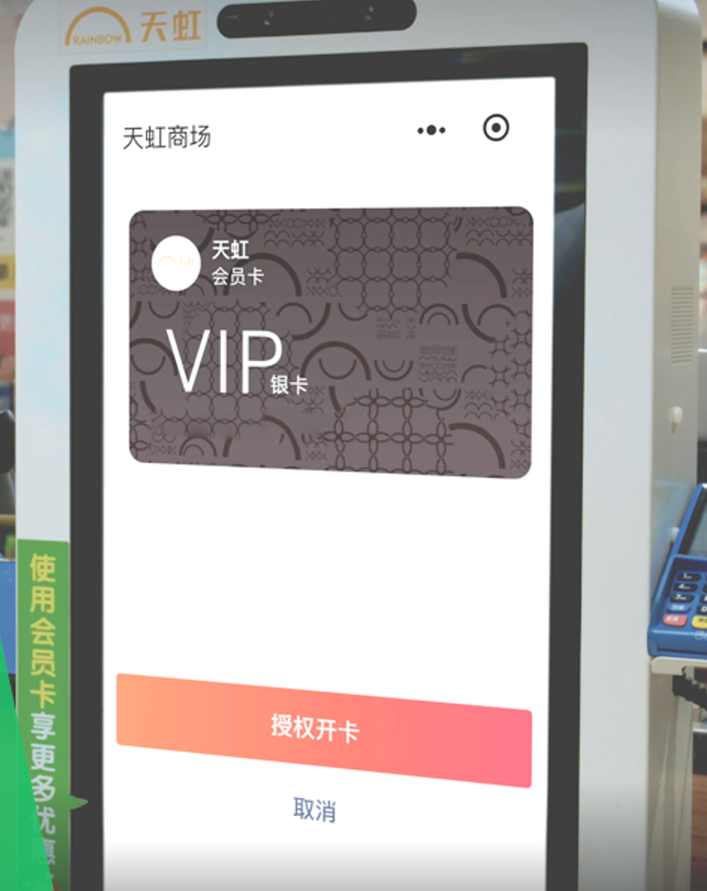
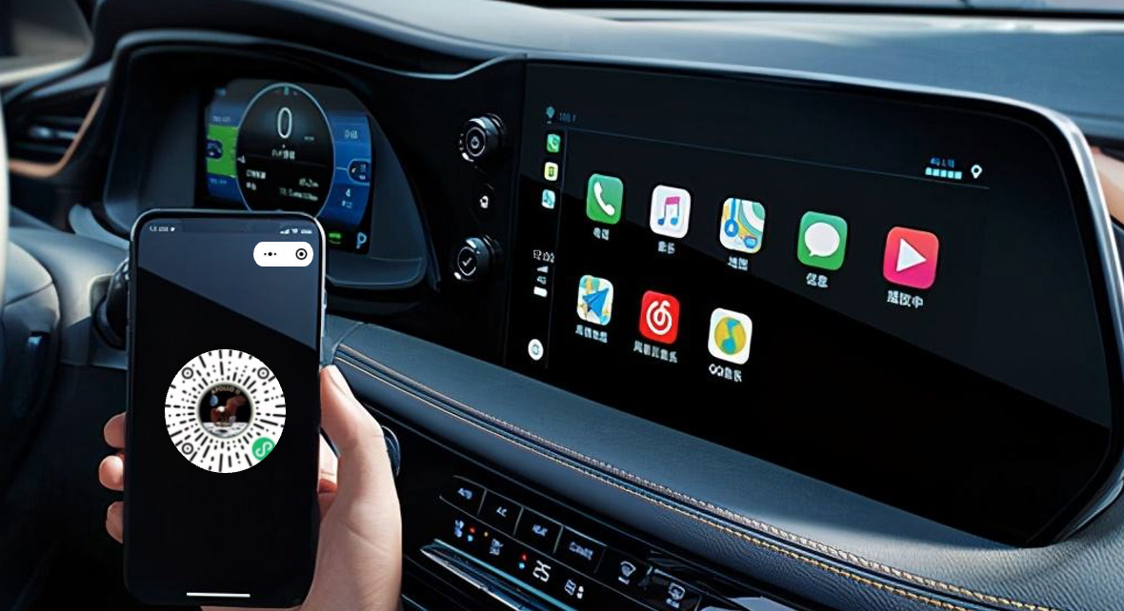
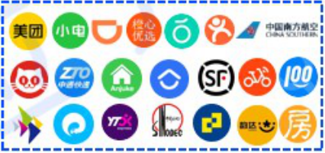








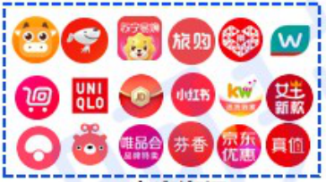
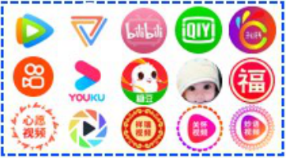
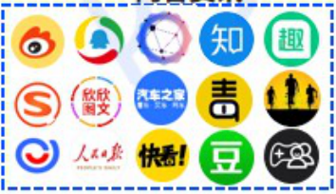
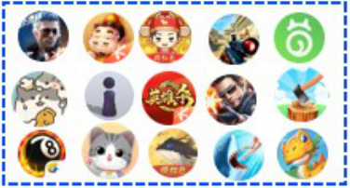
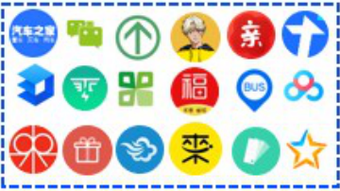

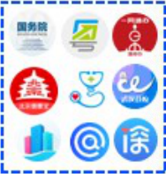
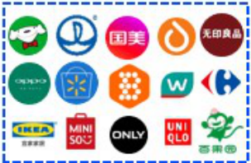
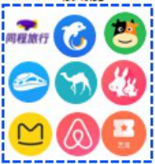
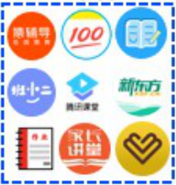


Super App with Open MiniApp Architecture
Mini app ecosystem
Mobile app
Mini app
PC app
Offline terminal
In-vehicle and IoT
Lifestyle services
Community group
Ecosystem scenarios
Finance
Government affairs
Pan-internet
Mobility
Lifestyle
Agriculture
Senior care
Online shopping
Video
Third-party enterprise registration
Internal development
Mini app security
App marketplace
Development platform
Mini app management
Data analysis
Internal mini app
Development management
Security scan
Security enhancement
Mini app marketplace
Template/Plugin
Content consulting
Gaming
Preview and debugging
Engineering management
Mini app container
Enterprise management
Tool
Social
Government affairs
App compilation
DevTools
IDE
Compatibility check
Rendering engine
Encrypted storage
Operations platform
Mini app review
Development framework
Team collaboration
Low-code development
API adaptation
Component framework
App management
Offline retail
Tourism
Education
App enhancement
Monitoring and analysis
App template
Security sandbox
Plugin extension
Catering
Photography
IaaS layer
Cloud base
Design review
Notes:
Models for dual-threaded rendering
One thread to render UI and one thread to service, the performance will be better
H5 package only uses one thread to load UI and Service at the same time

Slide 25
TMF MiniApp Platform- Core Features
Born From WeChat and More than WeChat
Develop once and run on multiple Environments
MiniApp Development Tools
MiniApp Management Portal
MiniApp Operation Analysis Platform
MiniApp Container
MiniApp Security
Provides a cross-platform development framework,
It can help developers unify the technology stack and develop only one set of code, which can run on WeChat, MiniApp( SupperAPP) platforms.
Provide customized MiniApp development tools, simplify the development, operation and debugging process of MiniApp, and help enterprises to create a one-stop development environment.
Provide a unified management platform for MiniApps, which can manage WeChat, MiniApps at the same time, with the same functions of their respective platforms, and provide enterprises with a unified management platform for MiniApps.
Provide key indicator statistics, performance monitoring, custom analysis, etc. to help iterative optimization and operation of MiniApp products. The main functions include standard analysis of daily routine statistics and custom analysis to meet the individual needs of users.
Embedded sandbox SDK, embedded in enterprise APP for privatized operation, no data privacy/information security concerns, and provides a supporting opertion and enterprise developer portal, enterprises have capabilities similar to WeChat
Provides security capabilities for MiniApps such as security scanning, reinforcement, password keyboard, channel, and security support such as privacy compliance and counterfeiting detection

Slide 26

Super App with Open MiniApp Architecture
Mini-App Development Framework
Hospital MiniApp
Taxi MiniAPP
Financial MiniAPP
MiniApp function display
MiniApp function display
MiniApp function display
Boot Entry
Service
Boot Entry
Service
Boot Entry
Service
Application function service A
MiniApp Marketplace
Hospital Service
Mini
app
Mini
app
E-shopping
Life service
Game
Government affairs
Mini
app
load on demand
Application function service B
Network
Taxi Service
Content consultation
Video
Tool
Community group buying
MiniApp Container
OS
Application function service C
Hardware
Financial Service
Offline Retail
Food
Travel
Education
Photograph
Social contact
Notes:
Models for dual-threaded rendering
One thread to render UI and one thread to service, the performance will be better
H5 package only uses one thread to load UI and Service at the same time

Slide 27




TMF MiniApp Architecture For SuperAPP
IDE development tools
MiniApp Multi-environment Framework
MiniApp Security
Stagging
API Management
Security scan
Project Management
MiniApp development stagging
Unified API
Application Template
UI Components
Template
Penetration Testing
Button
Text Box
Technical Template
Business Template
Compliance detection
Preview debugging
Table
…
Financial Template
…
Security hardening
Application compilation
Multi-environment compilation engine
Password Keyboard
Compatibility Check
Gateway Security
Operation & management
Counterfeiting Detection
Low-code development
Development Management
Operation & Analysis Management
Device Fingerprint
Teamwork
Publishing
Audit
Performance Analysis
Behavior Analysis
Authorization
Version
Retention Analysis
…
……
MiniApp Container
MiniApp Container SDK
MiniApp Developer Portal
MiniApp Operation Portal
Basic Components
JS SDK
Rendering Engine
Developers Management
Enterprise Application
MiniApp Development Management
Account management
Enterprise audit
MiniApp Review
National Secret Algorithm
API
Encrypted Storage
MiniApp Release management
Data Analysis
MiniApp Market
Associated APP
Monitoring and Analysis
Operation Log

Slide 28
Scenarios
Mini app development
-- Making enterprise business "competitive"
The mini app development suite supports same-code-multi-terminal programming, so that you can place your business in WeChat and your own mini apps and use super apps to acquire customers and grow your business.
Mini app container
-- Making enterprise business "inclusive"
You can leverage the WeChat mini program ecosystem to develop your own apps.
You can build your own mini app ecosystem by cultivating WeChat mini program running capabilities based on your own apps.

Slide 29



TMF MiniApp Container
SuperApp MiniApp Platform
Bank
MiniApp
On the shelf
Enterprise Management
APP Management
Tourism
MiniApp
On the shelf
MiniApp Marketplace
Role Management
Distribute SDK
Super APP
Issued
MiniApp Container
Monitor & Analysis
Transportation
MiniApp
On the shelf
MiniApp Management
License and version management
Compliance management
Entertainment
MiniApp
On the shelf
MiniApp Review
Contract Termination
MiniApps developed by third-party developers are put on the open platform for review
The supervision platform for the open ecology of MiniApp is far more secure than H5, and can achieve pre-check, in-process monitoring, and post-event control
The SupperApp integrates the MiniApp container, runs the MiniApps that has been approved by supervision.

Slide 30
TMF MiniApp Platform Components and API
Financial Keyboard
Security Components
Development Components
webview
Operation Feedback
Communication Components
Media Components
Technical Template
Device API
Route API
Navigation Components
Canvas
Table Components
View Container
basic components
Network API
Interaction API
Cross-platform framework
Unified Components
Unified API
Unified Security
Componentized development, more in line with front-end development specifications
Using WeChat MiniApp API specification, perfectly compatible with WeChat
Compatible with mainstream syntax such as React & Vue
Notes:
可灵活扩展

Slide 31
TMF MiniApp Platform Components and API
支付SDK
AR SDK
其他地图SDK
VOIP SDK
人脸识别SDK
扩展API
……
网络请求API
设备API
文件API
数据缓存API
位置API
开放接口API
基础API
路由API
小程序跳转API
界面交互API
媒体API
IOS使用微信小程序
API规范，兼容微信
Android使用微信小程
序API规范，兼容微信
IDE使用微信小程序
API规范，兼容微信
Notes:
可灵活扩展

Slide 32

TMF MiniApp Development Tools
Visual editor
Development Capability
Debug Capability
Drag and drop UI development
Scalable API
Extensible Widget Library
Automatic code generation
Code hints
Code specification check
PC side log debugging
Browser debugging
Cloud smartphone preview
One-click migration
Security Check
Packaging Capability
Check legacy resource API compatibility
Detect the adaptability of old resource component styles, etc.
One-click moving adaptation
Code inspection
Mini Program Compliance Scan
Support docking with Tencent applet security
Support multi-platform packaging
Plug-in extension support
Flexible docking with WeChat development tools

Slide 33

TMF MiniApp Analysis
SDK
Monitoring configuration
Defect monitoring
User behavior
Performance monitoring
Event
Behavior
Page
Anomaly Analysis
User
Monitoring runs through the entire process of user behavior
Slow Loading
Slow Request
JS Error
Analysis report
Statistics
Data Storage
Time
Web Service
customer attribution
Conversion Funnel
Use Behavior
Event Analysis
Retention Analysis
Path Analysis
Analysis Visualization
User Management
User Grouping
User Portrait
theme board
Teamwork
Drag and Drop analysis

Slide 34
TMF MiniApp Security Scanning
Client-side code security detection
Scan the MiniApp client code to detect whether the client has sensitive information leakage and whether the code protection strength is sufficient.
Server Security Check
By scanning the server environment, it can detect whether the server is using vulnerable or vulnerable software, and whether there is an unreasonable service configuration.
Business logic security detection
Check the security of the MiniApp business, check whether the business has risks, what permissions it has, whether it contains advertisements, etc.
MiniApp specific security detection
Detect whether the WeChat API calling from the MiniApp complies with the specification, and whether there is a risk of leakage of customer information or session information.

Slide 35







TMF MiniApp Security Reinforcement
By meaningless obfuscation of variables in JS files, the readability of the code is reduced and the code is not easy to be reversely analyzed
It can avoid the secondary packaging of all code class files after the package has been modified
Perform Security Checks and testing before publishing MiniAPP on SuperAPP
Anti Code Reverse
Anti Code Tampering
Anti Illegal Debugging
Anti Data Theft
step 1
step 2
step 3
step 4
Real-time monitoring of program debugging status to prevent code logic exposure
Security scan
Penetration testing
Security Reinforcement
Encrypt strings to prevent local data files from being stolen

Slide 36
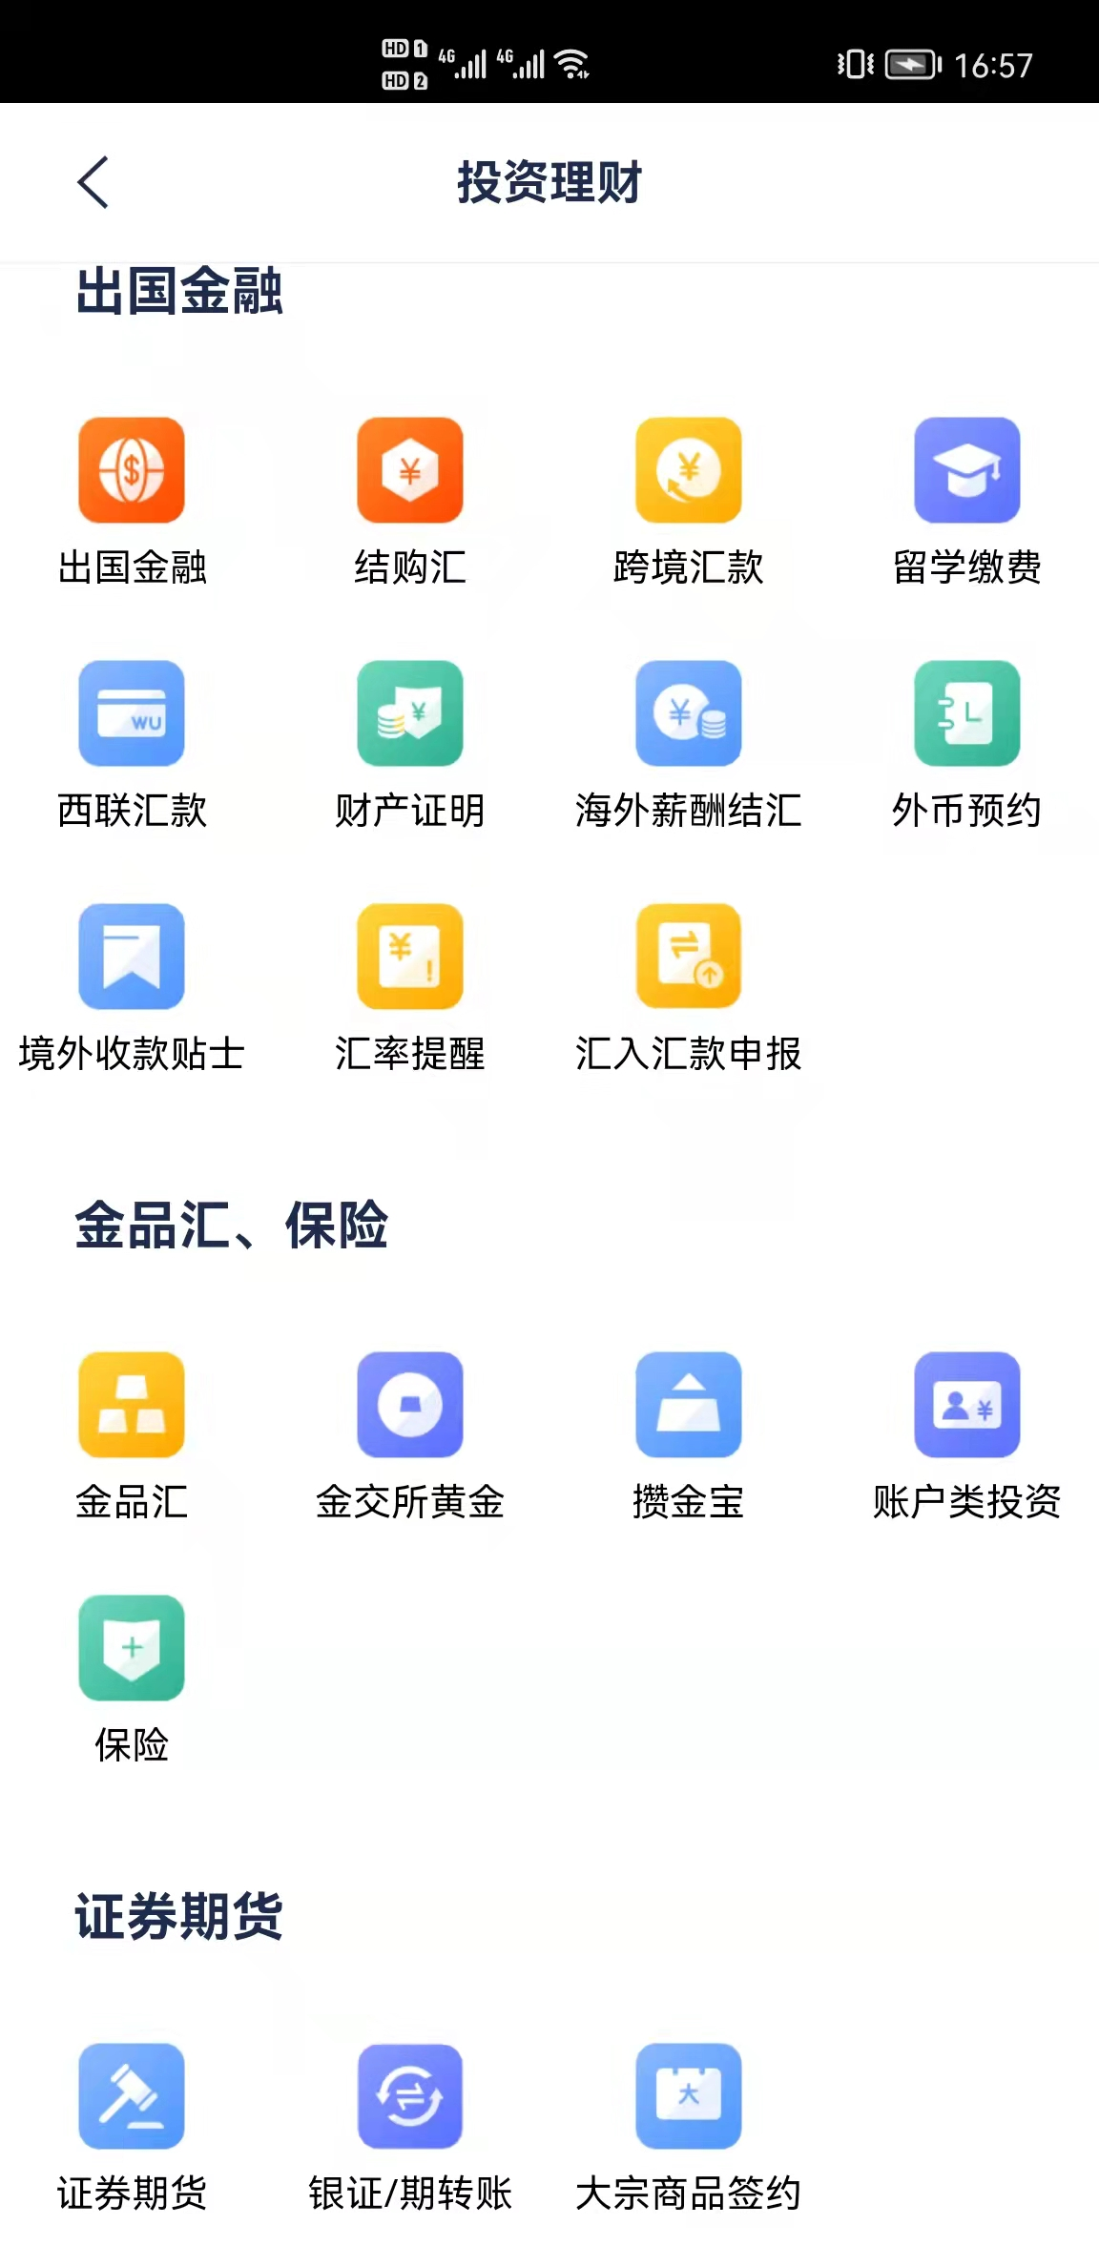


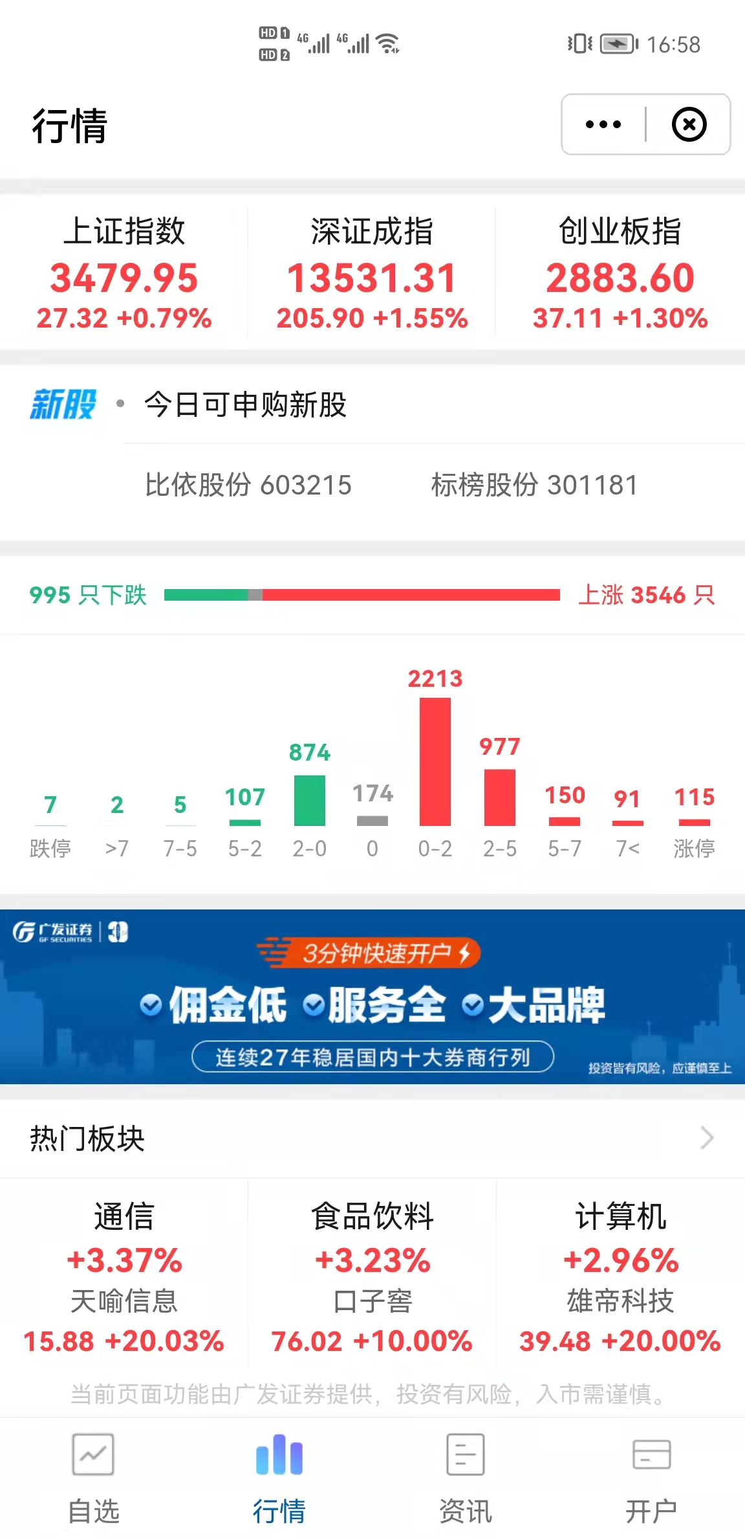




TMF MiniApp Migration
Migrate The WeChat Mini-App to Own Super App via “one-click”
MiniApp Open Platform
Service
A wider and deeper range of services
Analysis
Container
SDK
MiniAPP
Operation
Super APP
Ecology
A more diverse partner ecosystem
R&D

Slide 37
TMF Deployment Mode
DNS
AZ1
AZ2
Intranet LB
External LB/F5
TMF Deployment supports single DC HA, Dual AZ Active-standby and Dual AZ Active-Active deployment(by default).
All components and services designed in micro service architecture and deployed in both DCs. Services can be easily scaling.
Support on-cloud and on-prem deployment.
RPO=10min、RTO=15min
External LB/F5
Intranet LB
TKE
CDH
TDCA
TDCA
CDH
TKE
TMF Console
TCS Console
Data Collection
Data Collection
TCS Console
TMF Console
Monitoring
Alarms
Monitoring
Mobile analysis
Data query and monitoring
Data query and monitoring
Alarms
Mobile analysis
TARS-set1
Cross-center traffic scheduling
TARS-set2
Storage agent layer
Mobile Applications
Traffic scheduling
Traffic scheduling
Mobile Applications
Storage agent layer
Strong consistency mode
rclone
NAS/NFS
NAS/NFS
Strong consistency mode
Cross-center data access
Kafka Cluster
Cross-center consumption, local write, dual-center eventually consistent mode
Kafka Cluster
TDSQL
Master node
Credis Instance
CSP
Credis Instance
TDSQL
Slave node
CSP
Strong synchronization between master and slave nodes

Slide 38

Thanks！
Let more people and organizations benefit from the development of cloud technology
Notes:
我们希望，能让更多人和组织，因云端科技发展而受益。

